Slide 1
System Programming using C
Chapter 9 : C library Functions

Slide 2
Contents
Useful primitives:
Assert
Stdlib.h
Date and Time Functions.
System Calls:
Introduction
open(), read(), write(), close()
fork()
Ioctl()
Oops Concept:
Oops concept introduction
Advantages
Oops concept in C Programing with example project.
Referring to implementations:
Introduction to GNU glibc project.
Source code of GNU glibc.
How to find the implementation of stdlib.h function.
Syscall Implementation

Slide 3
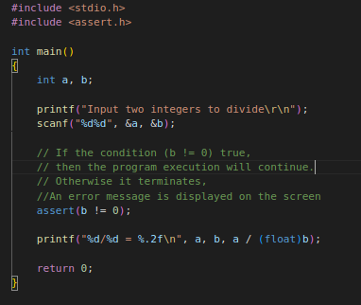
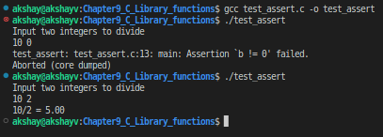
Assert()
Assert is a macro that is used to check specific conditions at runtime.
To use it, you must include the header file "assert.h" in the program.
Declaration: void assert(int expression);
If expression evaluates to TRUE, assert() does nothing.
If expression evaluates to FALSE, assert() displays an error message on stderr and aborts program execution.
Example Program: Demo for using the assert() macro. test_assert.c

Slide 4
C Library Functions - <stdlib.h>
The stdlib.h header defines four variable types, several macros, and various functions for performing general functions.
Members of the stdlib.h can be classified into the following categories:
Conversion
Memory
Process control
Sort and search
Mathematics.

Slide 5
Conversion functions
Function | Syntax | Descripton
atof | double atof(const char *str) | Convert String to Floating-Point
atoi | int atoi(const char *str) | Convert String to Integer
atol | long int atol(const char *str) | Convert String to Long Integer
strtod | double strtod(const char *str, char **endptr) | Convert String to Double
strtol | long int strtol(const char *str, char **endptr, int base) | Convert String to Long Integer
strtoll | long long strtoll(const char *nptr, char **endptr, int base); | Convert String to Long Long
strtoul | unsigned long int strtoul(const char *str, char **endptr, int base) | Convert String to Unsigned Long Integer

Slide 6
Dynamic Memory Allocation
Function​ | Syntax | Description​
malloc​ | (cast-data-type *)malloc(size-in-bytes); | Allocates the specified number of bytes​
realloc​ | void *realloc(void *ptr, size_t size); | Increases or decreases the size of the specified block of memory, moving it if necessary​
calloc​ | (cast-type*)calloc(n, element-size); | Allocates the specified number of bytes and initializes them to zero​
free​ | void free(void *ptr); | Releases the specified block of memory back to the system​

Slide 7
Process Control
Function | Syntax | Description
abort | void abort(void) | Abort Program
atexit | int atexit(void (*func)(void)) | Register Function to be Called at Program Exit
exit | void exit(int status) | Exit from Program
getenv | char *getenv(const char *name) | Get Environment String
system | int system(const char *string) | Perform Operating System Command

Slide 8
Binary Search
Function | Syntax | Description
bsearch | void *bsearch(const void *key, const void *base, size_t num_members, size_t size, int (*compare_function) (const void *, const void *)); Parameters or Arguments key The value to search for. base The address in a sorted array to begin the search. num_members The number of elements. size The size of the elements in bytes. compare_function A pointer to a comparison function. Returns The bsearch function returns: Negative = key less than the elemen Zero = key equal to element in array Positive integer = key greater than the element in the array | Binary Search

Slide 9
Sort
Function | Syntax | Description
qsort | void qsort(void *base, size_t num_members, size_t size, int (*compare_function) (const void *, const void *)); Parameters or Arguments base The array to sort. num_members The number of elements in the array. size The size of the elements in bytes. compare_function A pointer to a comparison function. Returns Negative = the first element in the array is less than the second element in the array Zero = the first element in the array is equal to the second element in the array Positive = the first element in the array is greater than the second element in the array | Sort Array

Slide 10
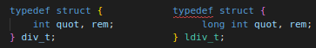
Mathematics
Function | Syntax | Description
int abs(int) | int abs(int x); | absolute value of an integer.
long int labs(long int) | long int labs(long int x); | absolute value of a long integer.
div | div_t div(int numerator, int denominator); | integer division (returns quotient and remainder)
ldiv | ldiv_t ldiv(long int numerator, long int denominator); | long integer division (returns quotient and remainder)
div_t and ldiv_t, are the return types of the div and ldiv functions. The standard defines them as:

Slide 11
C Library Functions contd..
Example program : Demo for standard library functions: test_stdlib.c
After reading and execution of code you be able to understand how to use these standard library functions.
To read more about stdlib.h, visit stdlib.h - Linux Man Page

Slide 12
Date and Time functions
The C date and time functions are a group of functions implementing date and time manipulation operations.
They provide support for time acquisition, conversion between date formats, and formatted output to strings.
The C date and time operations are defined in the time.h header file.
Time manipulation:
Description | Syntax | Description
difftime | double difftime( time_t time_end, time_t time_beg ); | computes the difference in seconds between two time_t values
time | time_t time( time_t *arg ); | returns the current time of the system as a time_t value, number of seconds, typically the Unix epoch.
clock | clock_t clock(void); | returns a processor tick count associated with the process
timespec_get (C11) | int timespec_get( struct timespec *ts, int base ); | returns a calendar time based on a time base

Slide 13
Time Format Conversions
Function | Syntax | Description
asctime | char* asctime( const struct tm* time_ptr ); | converts a struct tm object to a textual representation (deprecated)
ctime | char* ctime( const time_t* timer ); | converts a time_t value to a textual representation
strftime | size_t strftime( char * str, size_t count, const char * format, const struct tm * time ); | converts a struct tm object to custom textual representation
strptime | char *strptime(const char *s, const char *format, struct tm *tm); | converts a string with time information to a struct tm
wcsftime | size_t wcsftime( wchar_t* str, size_t count, const wchar_t* format, tm* time ); | converts a struct tm object to custom wide string textual representation
gmtime | struct tm *gmtime ( const time_t *timer ); | converts a time_t value to calendar time expressed as Coordinated Universal Time
localtime | struct tm *localtime ( const time_t *timer ); | converts a time_t value to calendar time expressed as local time
mktime | time_t mktime( struct tm *arg ); | converts calendar time to a time_t value.

Slide 14
Date and Time functions contd..
Example program : Demo for Date time Functions: test_time_func.c
After reading and execution of code you be able to understand how to use these Date time Functions.
To read more about time.h, visit time — Linux manual page

Slide 15
System Calls
A system call is a method for a computer program to request a service from the kernel of the operating system on which it is running.
The service is generally something that only the kernel has the privilege to do, such as doing I/O.
Programmers don’t normally need to be concerned with system calls because there are functions in the GNU C Library to do virtually everything that system calls do.
The Applications run in an area of memory known as user space. A system call connects to the operating system's kernel, which executes in kernel space.
For example : If the program wants to do device-specific input/output operations then you can just use ioctl().
Why do we need System Calls?
It is must require when a file system wants to create or delete a file.
Network connections require the system calls to sending and receiving data packets.
If you want to read or write a file, you need to system calls.
If you want to access hardware devices, including a printer, scanner, you need a system call.
System calls are used to create and manage new processes.
For more information visit: syscalls() - Linux manual page.
Types of System Calls:
Process Control
Fork()
Exit()
File Management
Open()
Read()
Device Management
Ioctl()
Read()
Information Maintenance
Getpid()
Alarm()
Communication
Wait()
Write()
Close()
Write()
Sleep()
Pipe()
Mmap()
Shmget()

Slide 16
System Calls contd..
open():
The open() system call allows you to access a file on a file system.
It allocates resources to the file and provides a handle that the process may refer to.
The return value of open() is a file descriptor, a small, nonnegative integer that is an index to an entry in the process's table of open file descriptors.
The file descriptor is used in subsequent system calls: read, write, close
Syntax:
fd = open (file_name, mode, permission);
Parameters:
file_name: Absolute path to file
mode:
O_RDONLY: read only,
O_WRONLY: write only,
O_RDWR: read and write,
O_CREAT: create file if it doesn’t exist,
O_EXCL: prevent creation if it already exists
permission: Notation of traditional Unix permissions Example: fd = open ("file", O_CREAT | O_RDWR, 0777);
Notation of traditional Unix permissions
Symbolic notation | Numeric notation | English
---------- | 0000 | no permissions
-rwx------ | 0700 | read, write, & execute only for owner
-rwxrwx--- | 0770 | read, write, & execute for owner and group
-rwxrwxrwx | 0777 | read, write, & execute for owner, group and others
---x--x--x | 0111 | execute
--w--w--w- | 0222 | write
--wx-wx-wx | 0333 | write & execute
-r--r--r-- | 0444 | read
-r-xr-xr-x | 0555 | read & execute
-rw-rw-rw- | 0666 | read & write
-rwxr----- | 0740 | owner can read, write, & execute; group can only read; others have no permissions

Slide 17
System Calls contd..
read():
It is used to obtain data from a file on the file system.
It accepts three arguments in general:
A file descriptor.
A buffer to store read data.
The number of bytes to read from the file.
The file descriptor of the file to be read could be used to identify it and open it using open() before reading.
Write():
It is used to write data from a user buffer to a device like a file.
This system call is one way for a program to generate data.
It takes three arguments in general:
A file descriptor.
A pointer to the buffer in which data is saved.
The number of bytes to be written from the buffer.
Syntax:​
length = read(file_descriptor , buffer, max_len);​
Example:​ n = read(0, buff, 50);​
Syntax:​
length = write(file_descriptor , buffer, len);
Example:​ n = write(fd, "Hello world!", 12);

Slide 18
System Calls contd..
Close() :
It is used to end file system access.
When this system call is invoked, it signifies that the program no longer requires the file, and the buffers are flushed, the file information is altered, and the file resources are de-allocated as a result.
Syntax:
int close(int fd);
fork():
fork() creates a new process by duplicating the calling process.
The new process is referred to as the child process. The calling process is referred to as the parent process.
The child process and the parent process run in separate memory spaces.
fork() return the following values:
Negative value - it represents the creation of the child process was unsuccessful.
Zero - it represents a new child process is created.
Positive value - The process ID of the child process to the parent. The returned process ID is type pid_t defined in sys/types.h. Usually, the process ID is an integer.
After a new child process is created, both processes will execute the next instruction following the fork() system call.
A child process uses the same pc(program counter), same CPU registers, same open files which use in the parent process.

Slide 19
Fork() contd..
Consider the Example 1:
Where one of the output came from the parent process and the other one from the child process.
Simply, we can tell that the result is 2 power of n, where n is the number of fork() system calls.
Consider the Example 2:
The number of times ‘hello’ is printed is equal to number of process created.
Total Number of Processes = 2^{n}, where n is number of fork system calls.
So here n = 3, 2³ = 8
The main process: P0 Processes created by the 1st fork: P1 Processes created by the 2nd fork: P2, P3 Processes created by the 3rd fork: P4, P5, P6, P7
Example Program: test_fork_call.c
Fork()
#include <stdio.h>
#include <sys/types.h>
#include <unistd.h>
int main()
{
/* fork a process */
fork();
/* the child and parent will execute every line of code after the fork (each separately)*/
printf("Hello world!\n");
return 0;
}
Pid = 1
Pid = 0
1
Hello wordl!
Hello wordl!
Output:
Hello world! Hello world!
#include <stdio.h> #include <sys/types.h> #include <unistd.h> #include <stdlib.h> int main() { fork(); // L1 fork(); // L2 fork(); // L3 printf("Hello world!\n"); return 0; }
L1
Output:
Hello world! Hello world! Hello world! Hello world! Hello world! Hello world! Hello world! Hello world!
2
L2
L2
L3
L3
L3
L3

Slide 20
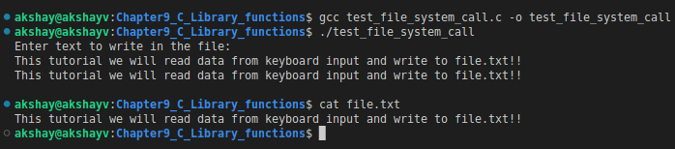
File management system calls
File Descriptor:
In Unix like computer OS, a file descriptor is a process-unique identifier for a file or input/output resource.
Each Unix process (except perhaps daemons) should have three standard POSIX file descriptors, corresponding to the three standard streams:
Integer value | Name | <unistd.h> symbolic constant | <stdio.h> file stream
0 | Standard input | STDIN_FILENO | stdin
1 | Standard output | STDOUT_FILENO | stdout
2 | Standard error | STDERR_FILENO | stderr
Here are some system calls for file management which operate on file descriptors:
open ()
read ()
write ()
close ()
Example Program:
test_file_system_call.c
New File "file.txt" created after script execution

Slide 21
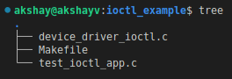
System Calls : ioctl()
Ioctl() is an abbreviation of input/output control.
It is a system call for device-specific input/output operations and other operations which cannot be expressed by regular system calls.
It takes a parameter specifying a request code; the effect of a call depends completely on the request code.
Request codes are often device-specific.
For instance, a CD-ROM device driver which can instruct a physical device to eject a disc would provide an ioctl request code to do so.
Steps involved in IOCTL:
Create IOCTL command in the driver
Write IOCTL function in the driver
Create IOCTL command in a Userspace application
Use the IOCTL system call in a Userspace
Example Program:
device_driver_ioctl.c : Simple Device driver with IOCTL
test_ioctl_app.c : Test app which usees IOCTL request.

Slide 22
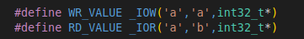
System Calls : ioctl() contd..
Define the ioctl command:
#define “Name of IOCTL” _IOx(num1, num2, argument type)
where IOx can be : “IO“: an ioctl with no parameters “IOW“: an ioctl with write parameters (copy_from_user) “IOR“: an ioctl with read parameters (copy_to_user) “IOWR“: an ioctl with both write and read parameters
num1: is a unique number or character that will differentiate our set of ioctl calls from the other ioctl calls. some times the major number for the device is used here.
num2: is the number that is assigned to the ioctl. This is used to differentiate the commands from one another.
argument type : Type of data.
Command example used in our driver:

Slide 23
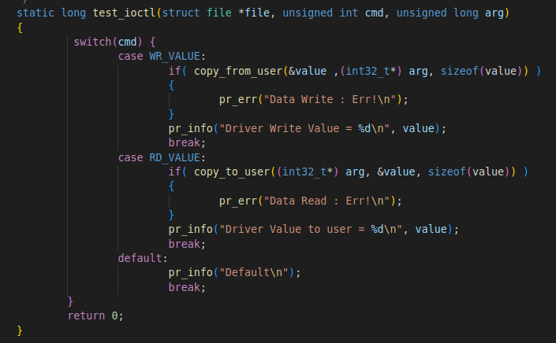
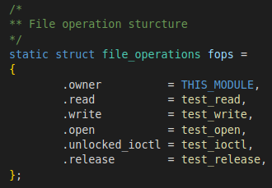
System Calls : ioctl() contd..
Write IOCTL function in the driver:
We need to add the ioctl function to our driver.
The prototype is as shown in image:
"file": the file pointer to the file that was passed by the application. "cmd" : the ioctl command that was called from the userspace. "arg": are the arguments passed from the userspace.
Within function we implement all the commands we defined.
To inform kernel that ioctl call is implemented in test_ioctl():
We make fops poiter unlocked_ioctl point to test_ioctl.

Slide 24
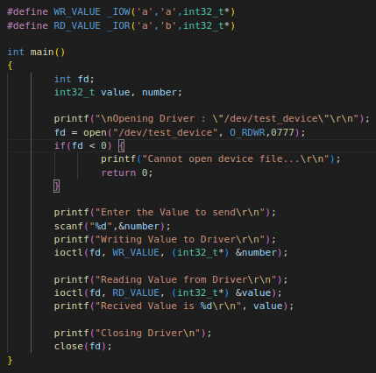
System Calls : ioctl() contd..
Create IOCTL command in a Userspace application :
In test_ioctl_app.c define the ioctl commands:
#define WR_VALUE _IOW('a','a',int32_t*)
#define RD_VALUE _IOR('a','b',int32_t*)
Use IOCTL system call in Userspace:
Open device "/dev/test_device".
Perform write & read calls:
ioctl(fd, WR_VALUE, (int32_t*) &number);
ioctl(fd, RD_VALUE, (int32_t*) &value);

Slide 25
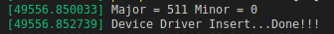
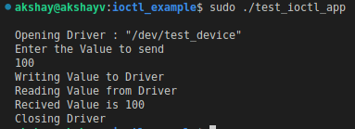
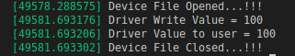
System Calls : ioctl() contd..
Build the driver by command:
sudo make
This will build the driver device_driver_ioctl.ko
Build the application code with command :
gcc -o test_ioctl_app test_ioctl_app.c
Load the driver into system using command :
sudo insmod device_driver_ioctl.ko
To check the driver is loaded run command :
sudo dmesg
dmesg is a command that prints the message buffer of the kernel.
Run the application using command :
sudo ./test_ioctl_app
Again check dmesg to see the log.
To unload the driver use command:
sudo rmmod device_driver_ioctl.ko
Dmesg log after loading driver
Dmesg log after running app

Slide 26
Oops concept
Oops, is a programming model based on the concept of objects and classes.
In this model, programmers define the functions that can be applicable to the data structures and their data type.
Object-oriented programming turns data structure into an object, including both data and functions.
It encourages the reusing of these objects in the same and other programmes as well.
These days, most major software development is performed using OOP.
With OOP, instead of writing a program, you create classes.
A class contains both data and functions.
When you want to create something in memory, you create an object, which is an instance of that class.
For example : We create class CAR which holds data & functions related to CAR.
When your program want to create a CAR in memory, then a new object of CAR is created.
Object
CAR
Brand
Model
Colour
Fuel
Data Members
Start()
Stop()
Move()
Functions
Class
It is a user-defined data type, which holds its own data members and member functions, which can be accessed and used by creating an instance of that class
Object
An Object is an instance of a Class.
It is allocated memory when instantiated.

Slide 27
Oops Concept contd..
Encapsulation
Encapsulation is defined as binding together the data and the functions that manipulate them.
Example : The internal details of a CAR, how the car starts, How it stops.
Encapsulation means hiding the internal details or mechanics of how an object does something.
Abstraction
It allows programmers to be abstract or pick out common features of the objects and procedures.
It means hiding internal details and showing functionality.
For example, a customer may only use a few selections of CAR like fuel, accelerator, clutch, brake, wheel and odometer.
To run the CAR many pieces work together, so this info is not exposed to customer.

Slide 28
Oops Concept contd..
It is a mechanism where programmers can derive a class from another class.
Inheritance
It can be useful in giving custom logic to existing frameworks and in declaring different exceptions.
Inheritance also allows programmers to reuse previously written codes.
For example, one can create two child classes and name them hatchback and sedan inherited from the parent class car.
It allows programmers to build logical codes.
Polymorphism
Programmers can access objects of different types through the same interface where each type provides its own implementation of the interface.
Compile-time polymorphism:
Method overloading is an example of compile-time polymorphism.
It allows programmers to use objects of the same name while their parameters can be different.
Runtime polymorphism:
Method overriding is an example of runtime polymorphism.
In this process, an object binds with the functionality at the run time.

Slide 29
Oops Concept contd..
Polymorphism
Int main()
{
Sum1 = sum(2,5);
Sum2 = sum(20,23,1);
}
Advantages of Oops:
Modularity for easier troubleshooting:
You know exactly where to look when something goes wrong. “Oh, the car object broke down? The problem must be in the Car class!”
Reuse of code through inheritance:
Create one generic class (Car), and then define the subclasses (Sedan , Hatchback, SUV etc.)
Flexibility through polymorphism
Because a single function can shape-shift to adapt to whichever class it’s in, you could create one function in the parent Add class called sum() -- not sum2elements() or sum3elements() but just sum().
Int sum(int a, int b)
{
return a+b;
}
Int sum(int a, int b, int c)
{
return a+b+c;
}

Slide 30
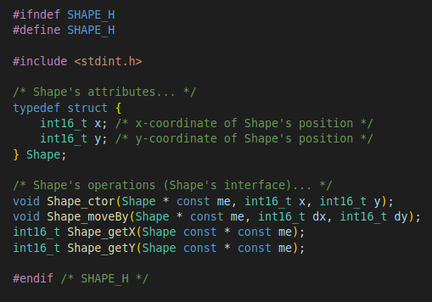
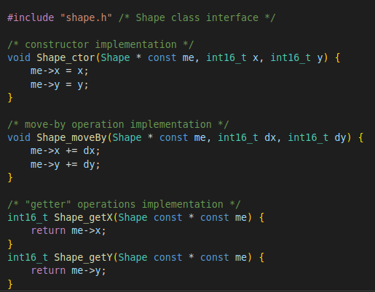
Oops Concept contd..
Oops concept in C Programming:
Although the fundamental OOP concepts have been traditionally associated with object-oriented languages, such as C++, or Java.
You can implement them in almost any programming language including portable, standard-compliant C (ISO-C90 Standard).
One good reference for implementation of Oops concepts can be found here OOP-in-C.
Consider we have an application that employs 2D shapes to be render on Graphic-LCD. We can come up with our classes.
Encapsulation in C :
Attributes of class are defined with C struct
Operations of class are defined as C functions.
Consider the Application : Chapter9_C_Library_functions/OOPS_in_C/encapsulation
Shape class
shape.h
shape.c

Slide 31
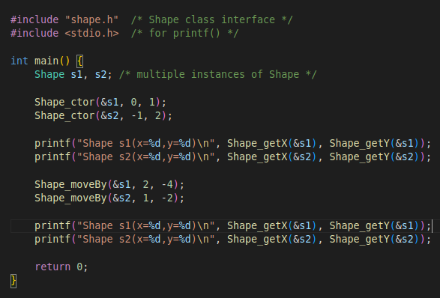
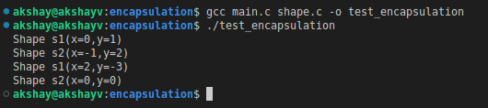
Oops Concept contd..
Oops concept in C Programming:
Encapsulation in C :
Compile the code : gcc main.c shape.c -o test_encapsulation
Shape_getX() & Shape_getY() : Get the value of x & y attributes
Shape_moveBy() : will add dx & dy to x & y attributes.
This will move the 2D shape on graph according to new x and y attrbutes.
main.c

Slide 32
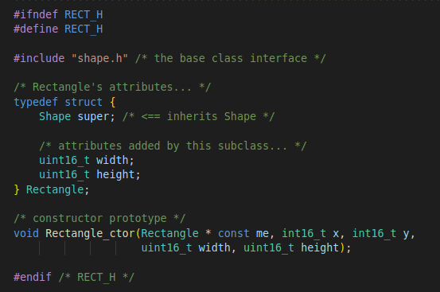
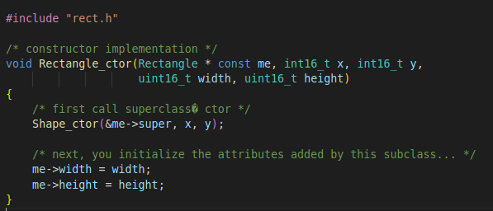
Oops Concept contd..
Oops concept in C Programming:
Inheritance:
Instead of creating the new class for Rectangle from scratch.
We can inherit what most common from the Shape class & add only what is different for defining rectangles.
Consider the Application : Chapter9_C_Library_functions/OOPS_in_C/inheritance
Rectangle Class:
rect.h
rect.c

Slide 33
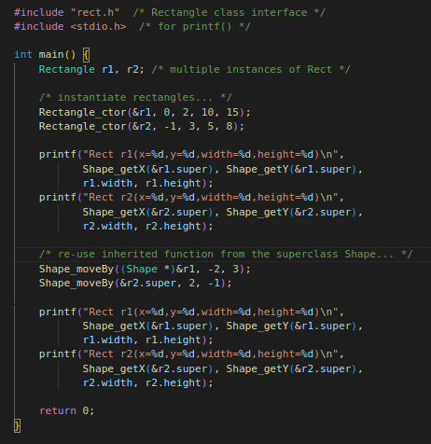
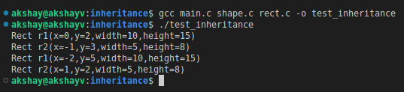
Oops Concept contd..
Oops concept in C Programming:
Inheritance:
Output observations:
You can see how to instantiate the rectangle: Rectangle_ctor()
Using Shape_moveBy() we can change the shape on x and y coordinates
main.c

Slide 34
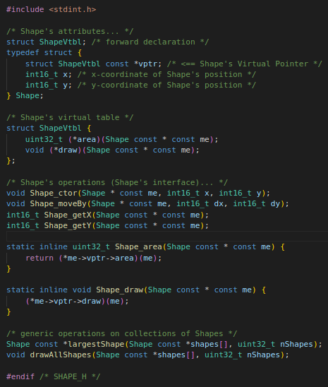
Oops Concept contd..
Oops concept in C Programming:
Polymorphism (Virtual Function)in C:
Consider the Shape class we saw before.
We can provide more useful operations :
area(): To calculate area of shape
draw() : to draw the shape on screen when integrated with G-LCD.
But Shape class cannot provide the implementation of different shapes like circle, rectangle.
But it can provide basic interface for those operations:
Shape_area() , Shape_draw().
Consider example:
Chapter9_C_Library_functions/OOPS_in_C/polymorphism
We define the structure Shape with Shape's virtual pointer
This interface will allow us to write generic code to manipulate the shapes .
shape.h

Slide 35
Oops Concept contd..
Oops concept in C Programming:
Polymorphism (Virtual Function)in C:
Virtual functions : Shape_area() & Shape_draw() can have different implementation for subclass rectangle & Circle:
Rect subclass of Shape :
Area calculation is : width * height
Circle subclass of Shape :
Area Calculation is : pi * radius²
This means the virtual function call cannot be resolved at link type as we do for normal function in C.
The actual version of function call will depend on the type of object Rect or Circle.
ShapeVtbl : Is table of function pointers corresponding to virtual functions.
Vptr is pointer to Virtual table of class
This pointer must be present for each class.
Vptr is declared as pointer to an immutable object see const keyword in front of it.
Vptr should not change and is allocated in ROM,
shape.h

Slide 36
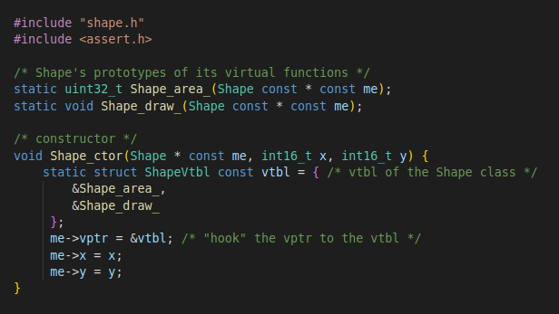
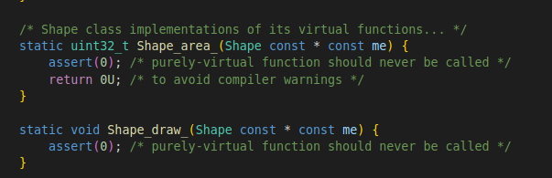
Oops Concept contd..
Oops concept in C Programming:
Polymorphism (Virtual Function)in C:
Setting vtpr in constructor:
The vptr must be initializes to corresponding Virtual Table in every instance of class.
In c you need to initialize the vptr in Shape constructor as implemented in shape.c in Shape_ctor()
The vtbl is initialized to function pointers Shape_area_() & Shape_draw_().
If class cannot provide implementation of its virtual functions, as it is an abstract class of Shape, the implementations should assert internally.
shape.c
shape.c

Slide 37
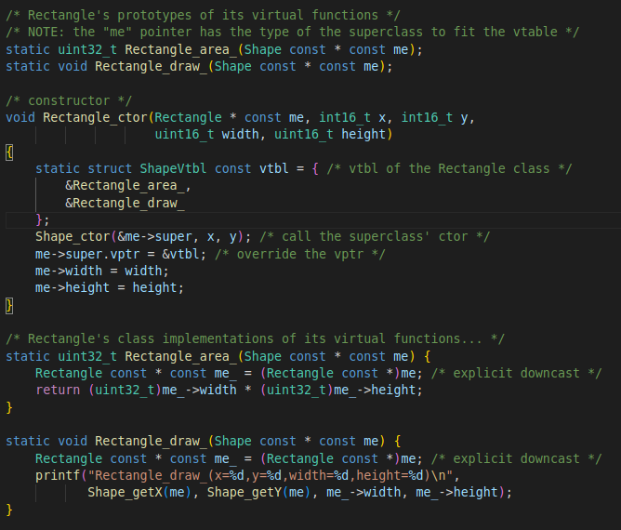
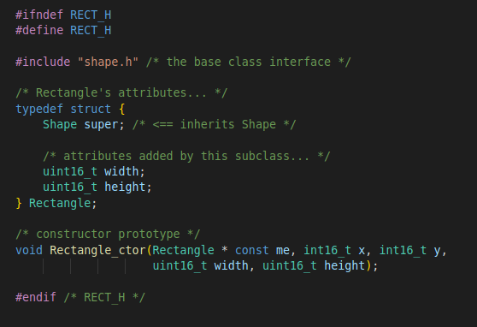
Oops Concept contd..
Polymorphism (Virtual Function)in C:
Inheriting the vtbl & Overriding vptr
vptr is inherited automatically by all subclasses.
vptr needs to be re-assigned to the vtbl of specific subclas.
This re-assignment must happen inside subclass constructor.
For example consider :rect.h subclasses of Shape
rect.c
rect.h

Slide 38
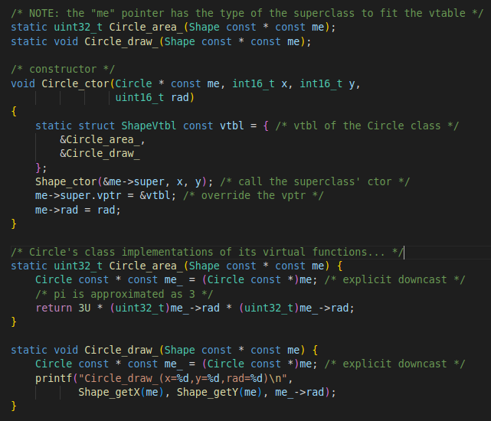
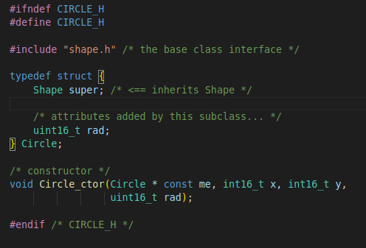
Oops Concept contd..
Polymorphism (Virtual Function)in C:
Inheriting the vtbl & Overriding vptr
For example consider :circle.h subclasses of Shape
Shape_ctor() is called first to initialize the me->super member inherited from Shape.
This sets the vptr to point Shape vtbl.
Next statement vptr is overridden where it is assigned to Circle's vtbl
circle.c
circle.h

Slide 39
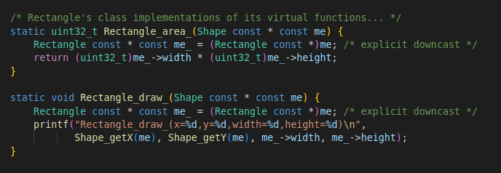
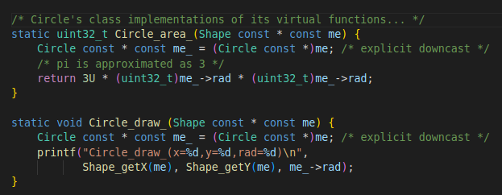
Oops Concept contd..
Virtual Call Mechanism for Rectangle & Circle Class:
Rectangle Object
vptr
x
y
width
height
Rectangle vtbl
&Rectangle_area_
&Rectangle_draw_
Circle Object
vptr
x
y
rad
Circle vtbl
&Circle_area_
&Circle_draw_

Slide 40
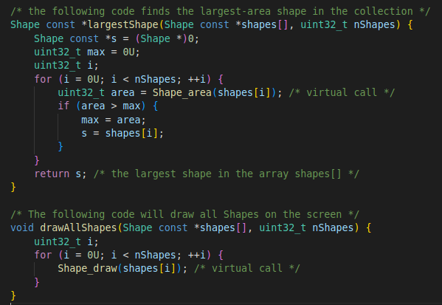
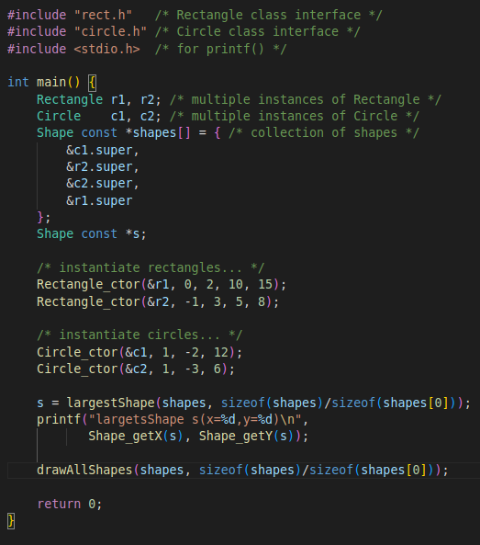
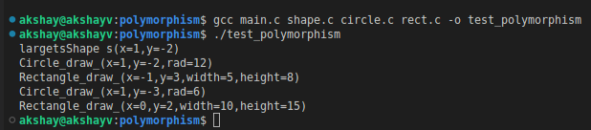
Oops Concept contd..
Polymorphism (Virtual Function)in C:
Consider main.c :
shape.c
main.c
This run's a loop on array of *shapes[] and finds max area by using virtual function of each subclass.
Returns shape with largest area.
Collection of different shapes
Instantiate the attributes of Rect & Circle
This run's a loop on array of *shapes[] & calls the virtual function to draw shape for each subclass.
Largest shape c1
Draw All shapes

Slide 41
Oops Concept contd..
Linux Open Source Code :
QP/C
The oops concepts are implemented in the QP/C real-time framework.
QP™/C Real-Time Embedded Framework (RTEF) is a lightweight implementation of the Active Object model of computation specifically tailored for real-time embedded (RTE) systems.
QP is both a software infrastructure for building applications consisting of active objects (actors) and a runtime environment for executing the active objects in a deterministic fashion.
QP™/C is licensed under the sustainable dual licensing model, in which both the open source software distribution mechanism and traditional closed source software distribution models are combined.

Slide 42
Assignment - Inter process communications
What is Inter process Communication (IPC):
It is mechanism which allows exchange of data / messages between multiple processes.
Why use IPC:
Data Sharing between processes .
Dividing a task in multiple process or threads can speed up the task in parallel.
Providing mechanism to communicate with other processes brings modularity in the system.
Big application can be broken into modules.
IPC Mechanism
Process 1
Process 4
IPC Mechanism
IPC Mechanism
Process 2
Process 3

Slide 43
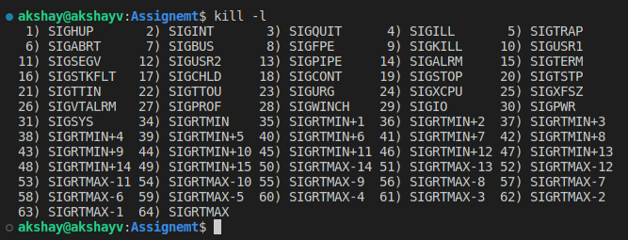
Assignment - Inter process communications
Signals:
Signals are messages sent to running process to trigger specific behavior, for e.g quitting the process or error handling.
They provide limited inter-process communication.
It is an async notification sent to process of thread to notify of an event.
When a signal is sent the OS interrupts the process, if a signal handler is registered by process then that handler is executed.
Signal are similar to interrupts but interrupts are mediated by CPU & handled by Kernel in OS based environment.
On other hand signals are mediated by kernel & handled by Process.
Signal can be specified with a number or a name.
Usually name starts with SIG.
To check available signals run command:
kill -l
-l : list the signal names;

Slide 44
Assignment - Inter process communications
Raising Signals:
Kill(2):
The kill() system call can be used to send any signal to any process group or process.
int kill(pid_t pid, int sig);
If pid is positive, then signal sig is sent to the process with the ID specified by pid.
If pid equals 0, then sig is sent to every process in the process group of the calling process.
If pid equals -1, then sig is sent to every process for which the calling process has permission to send signals, except for process 1 (init)
Key Combinations in Terminal:
Ctrl + C : sends SIGINT interrupt signal, by default it causes to terminate process.
Ctrl + Z : sends SIGTSTP terminal stop, by default it causes the process to terminate.
Ctrl + \ : sends SIGQUIT signal, by default it causes the process to terminate and dump core.
Ctrl+ T : sends SIGINFO, by default if supported by the command this causes the OS to show information about running command

Slide 45
Assignment - Inter process communications
Handling Signals:
The actions performed for the signals are raised −
Default Action
Handle the signal
Ignore the signal
Signals can be handled by altering the execution of the default action.
There are two system calls : signal() & sigaction()
Sigaction():
To examine and change a signal action.
It is a system call, used to change the action taken by a process on receipt of a specific signal.
It allows calling process to examine and/or specify the action to be associated with signal.
int sigaction(int signum, const struct sigaction *restrict act, struct sigaction *restrict oldact);
signum - specifies the signal and can be any valid signal except SIGKILL and SIGSTOP.
act - is non-NULL, the new action for signal signum is installed from act.
oldact - is non-NULL, the previous action is saved in oldact.
sigaction structure :
struct sigaction { void (*sa_handler)(int); void (*sa_sigaction)(int, siginfo_t *, void *); sigset_t sa_mask; int sa_flags; void (*sa_restorer)(void); };

Slide 46
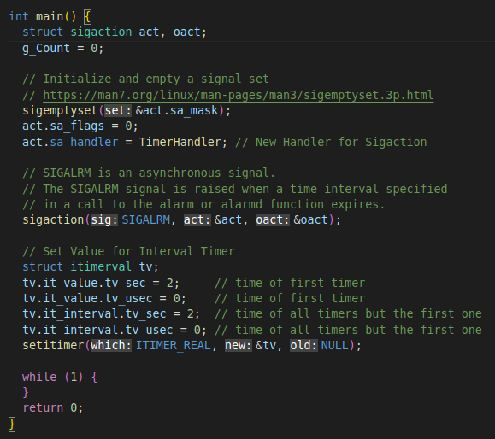
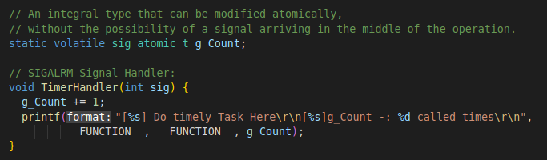
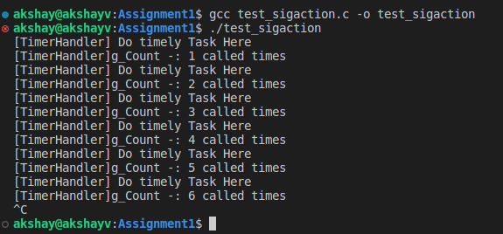
Assignment - Inter process communications
Sigaction():
Consider the Example: Chapter9_C_Library_functions/Assignment1/test_sigaction.c
SIGALRM Handler
Set timer to generate alarm signal parodically
Output

Slide 47
Assignment - Inter process communications
Signal():
Signal() call the registered handler upon generation of signal.
typedef void (*sighandler_t)(int);
sighandler_t signal(int signum, sighandler_t handler);
The handler can be :
SIG_IGN – Ignore Signal
SIG_DFL – Default signal handling mechanism
User Handler function address - User defined signal handler function address that will be called on signal generation.
When signal signum is delivered to the process, then one of the above handler will be called.
Consider the Example: Chapter9_C_Library_functions/Assignment1/test_signal_ipc.c
The example user fork() system call, to create a new process by duplicating the calling process.
The new process is referred to as the CHILD process.
The calling process is referred to as the PARENT process.
The Parent sends following signals to Child: SIGHUP, SIGINT, SIGQUIT using kill().
The Child process uses signal() to register the handler function for the signals.

Slide 48
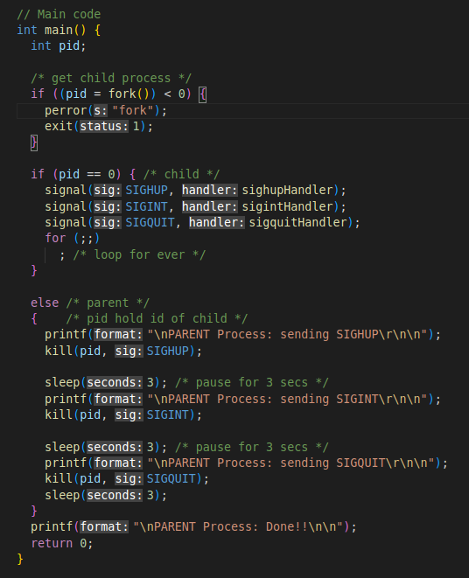
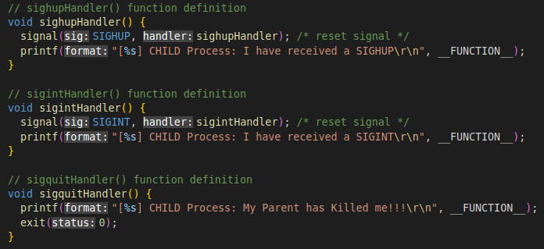
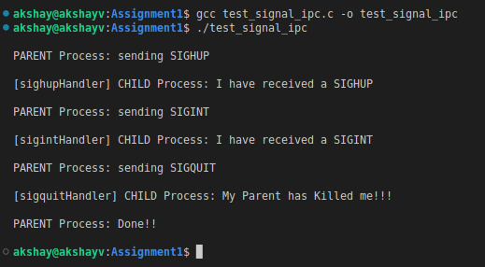
Assignment - Inter process communications
Signal():

Slide 49
Assignment - Inter process communications
Networking sockets
In user space the abstraction of network communication is the socket.
Sockets are a way to enable inter-process communication between programs running on a server, or between programs running on separate servers.
Communication between servers relies on network sockets, which use the Internet Protocol (IP) to encapsulate and handle sending and receiving data.
Network sockets on both clients and servers are referred to by their socket address.
An address is a unique combination of a transport protocol like the Transmission Control Protocol (TCP) or User Datagram Protocol (UDP), an IP address, and a port number.
Different types of sockets that are used for inter-process communication:
Stream sockets, which use TCP as their underlying transport protocol
Datagram sockets, which use UDP as their underlying transport protocol
Unix Domain Sockets, which use local files to send and receive data instead of network interfaces and IP packets.
Stream sockets are connection oriented, which means that packets sent to and received from a network socket are delivered by the host operating system in order for processing by an application.
Network based stream sockets typically use the Transmission Control Protocol (TCP) to encapsulate and transmit data over a network interface.
TCP is designed to be a reliable network protocol that relies on a stateful connection.

Slide 50
Assignment - Inter process communications
Stream Socket:
Server Process
Client Process
Function Call | Description
socket() | To create a socket
bind() | Used to associate the socket with local address i.e. IP Address, port and address family.
listen() | Ready to receive a connection
connect() | Used by the client application to establish a connection to a server.
accept() | Confirmation, it is like accepting to receive a call from a sender
send() | To send data
read() | To receive data
close() | To close a connection
1
socket()
4
socket()
2
bind()
5
connect()
3
listen()
6
accept()
send()
read()
7
read()
send()
Sockets Facilitate Communication
close()
8
close()

Slide 51
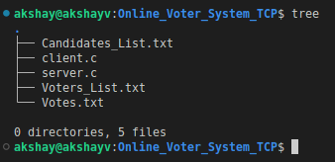
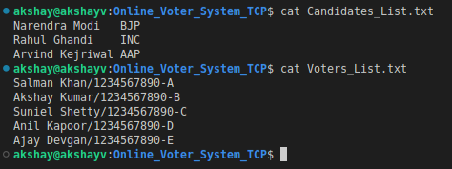
Assignment - Inter process communications
Networking sockets
Consider the Example: Chapter9_C_Library_functions/Assignment1/Online_Voter_System_TCP
The example shows how to use TCP/IP in application development.
The system is Simple Online Voter application using TCP.
The server.c implement the server, it runs the application for Server of Online Voter System.
The client.c Implement a simple client app for voting that can be used to record the Vote.
Both server and client communicate with each other on Localhost and Port : 3456.
Client receives the information from user & sends that to the server.
Server validates the input messages received and replies to the client.
Candidates_List.txt : Candidate List
Voters_List.txt : Data of voters list.
The Server received the voter info from client.
Validates the voter is present in list.
Votes.txt : Server saves the Votes in this file

Slide 52
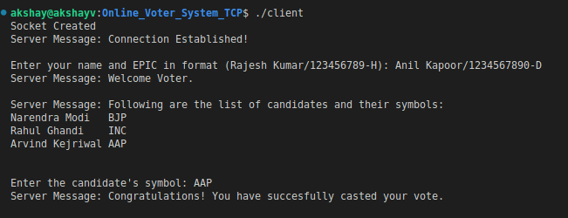
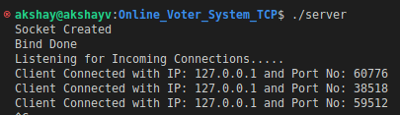
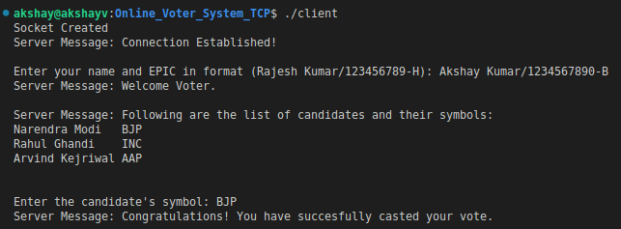
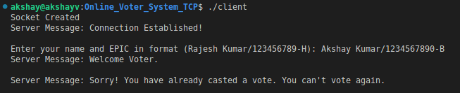
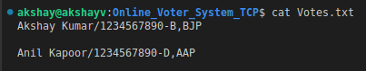
Assignment - Inter process communications
Networking sockets
Build the Application using: server.c : gcc -pthread server.c -o server client.c: gcc client.c -o client
Final Votes List

Slide 53
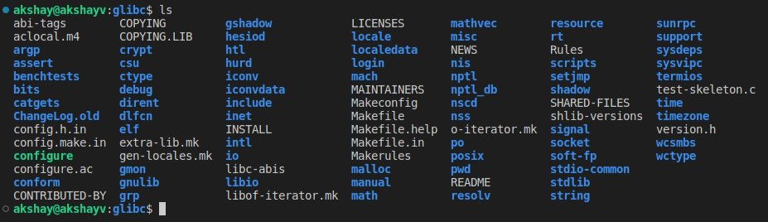
GNU C Library (glibc) project
The GNU C Library is used as *the* C library in the GNU system and in GNU/Linux systems, as well as many other systems that use Linux as the kernel.
The GNU C Library is primarily designed to be a portable and high performance C library.
The GNU C Library webpage is at http://www.gnu.org/software/libc/
We can study the implementation of libraries in glibc just download the source code.
Clone the latest glibc 2.36 source code:
git clone https://sourceware.org/git/glibc.git
cd glibc
git checkout release/2.36/master

Slide 54
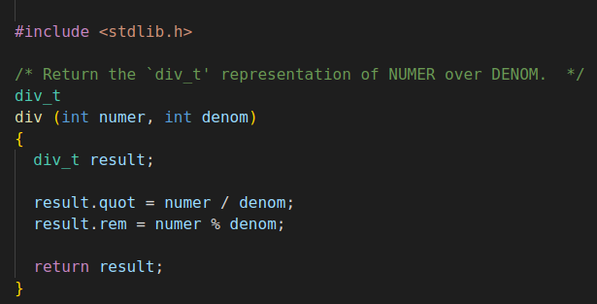
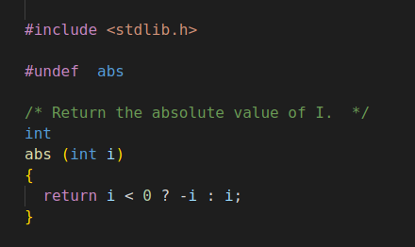
GNU C Library (glibc) project contd..
You can find the implementation of all the lbrary function in this repo.
For eg : stdlib
We studied some stdlib.h library functions in this chapter.
In the glibc/stdlib directory we can find the implementation of those functions.
For eg:
Mathematical function div() in div.c
Abs() Get Absolute value of number in abs.c

Slide 55
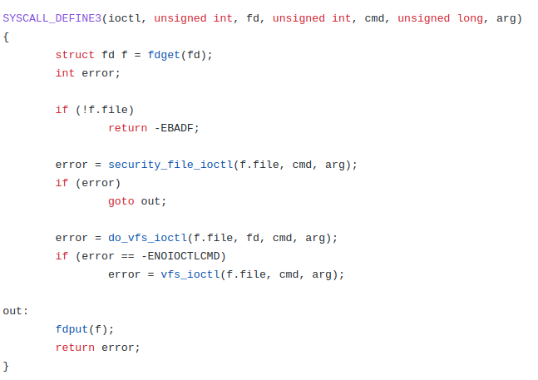
Linux Syscall Implementation:
In order to read the System calls implementation we should look into Linux Kernel Sources.
Linux Kernel Source Can be found on github: https://github.com/torvalds/linux
System calls are not stored in just one particular location in whole kernel tree.
This is because different syscalls can refer to different parts of system :
Process Management – fork(), exit(), exec()
File management – open(), read(), write(), close()
Device Management - ioctl()
Information Maintenance – getpid(), alarm(), sleep()
You can read SYSCALL_DEFINE[0-6] macro.
For example : fs/ioctl.c

Slide 56


Linux Syscall Implementation:
For example : kernel/fork.c
fork()
For example : kernel/sys.c
getpid()

Slide 57

Linux Syscall Implementation:
For example : fs/open.c
open()

Slide 58

Assignment - Creating Libraries
A library is a pre-compiled code that can be reused in an application.
Libraries give reusable functions, data structures, routines that can be reused in the code.
Static libraries:
A Static library or statically-linked library is a set of external functions, variables & routines, which are resolved in a caller at compile-time
Static libraries are collections of object files which are linked into the stand-alone executable program, with the prefix “lib” and ".a" extension
Static libraries are faster than the shared libraries as a set of commonly used object files is put into a single library executable file.
Static libraries are bigger in size, as external programs are built in the executable file.
Example code:
To demonstrate static library creation we have set of code files inside directory:
"Chapter9_C_Library_functions/Assignment2/shared-lib"
calculator.c : Library to perform basic math operation.
print_lib.c : Print the terminal characters in colour.
header.h : Include file with all function prototypes.
main.c : Application code

Slide 59

Assignment - Creating Libraries
Steps to generate a static c libraries in Linux:
Compile all of our library source code into an object file, GCC do this using command:
gcc -c calculator.c print_lib.c
We use GNU ar command to create final library or archive file:
The archiver, also called ar, is a Unix utility that maintains groups of files as a single archive file.
ar -cr libDemo.a *.o -c : Create the archive.
-r : updates the library with the most recent version of any existing object file.
Now we can compile the main.c :
gcc main.c -L. libDemo.a -o main
-L : flag indicates to the linker that libraries might be found in the current directory (referred to with ‘.’)
Run the main executable.

Slide 60

Assignment - Creating Libraries
Dynamic libraries:
Also called Shared Libraries.
A shared library or Dynamic Library is loaded dynamically at runtime for each application that needs it.
Dynamic Linking doesn’t require the code to be copied.
It is done by placing name of the library in the binary file.
Actual linking is done when the program is executed, both the binary file & the library are in memory.
Example code:
To demonstrate static library creation we have set of code files inside directory:
"Chapter9_C_Library_functions/Assignment2/dynamic-lib"
calculator.c : Library to perform basic math operation.
print_lib.c : Print the terminal characters in colour.
header.h : Include file with all function prototypes.
main.c : Application code

Slide 61
Assignment - Creating Libraries
Steps to generate a dynamic c libraries in Linux:
We need to compile all of our library source code into an object file so we inform GCC to do this using command :
gcc -c -fPIC calculator.c print_lib.c
-fPIC flag generates position-independent code, which accesses all constant addresses stored in the Global Offset Table (GOT).
Create Library file:
It has a format that is specific to the architecture for which the lib is created.
We need to use the compiler to create a library, for this we need to inform compiler that it should create a shared library, not a final program executable file.
This is achieved using the '-shared' flag.
gcc -shared -o libDemo.so *.o
Install Library:
The shared library will not be found at runtime if its directory is not in the variable LD_LIBRARY_PATH.
Type the following command add it:
export LD_LIBRARY_PATH=.:$LD_LIBRARY_PATH
In our example the local directory ('.') is added to the search.
The new path list will be effective only in the shell where you applied the command.

Slide 62

Assignment - Creating Libraries
Steps to generate a dynamic c libraries in Linux::
Build the executable:
To create the executable, you first compile the source file:
gcc -c main.c
Then link the created code main.o with the library:
gcc -o main main.o -L. -lDemo
'-L' indicates where the library is to be found
'-l' specifies the library, without the prepending 'lib' and file extension '.so'.
Finally run the executable

Slide 63



Assignment - Creating Libraries
Consider you have a big project with multiple .c/.h files:
Consider the Example : Chapter9_C_Library_functions/Assignment2/c-utils
You can create for eg : shared library of all the Source files.
In our case consider directory src/ , It contains all the source files what we can use in our main app.
In directory examples/ contains the application programs that use the files from Src/.
Go through all the source codes.
Makefile – Since there are many files we can write a makefile to build the library and example codes.
Makefile
Directory structure, Library name & Compile flags
This section compiles the Shared library & builds example codes
Makefile

Slide 64


Assignment - Creating Libraries
Build Library & Example Codes: make all
Final Build Executables of Example codes are output to directory dist/
Compile all of our library source code into an object file
Create final library or archive file
Compile Example codes with Library

Slide 65



Assignment - Creating Libraries
Run the examples:

